Slide 1
Big Data with Apache Spark and Java
Analyze huge amount of data in Distributed manner
Nikki Yodo

Slide 2
Introduction
Experience: Software, DevOps, Cloud Ops engineer
GitHub: https://github.com/nik-yo
LinkedIn: https://www.linkedin.com/in/nikkiyodo/
Consulting: www.nikyotech.com
Email: nikki.yodo@nikyotech.com

Slide 3
What is Apache Spark?
Apache Spark™ is a multi-language engine for executing data engineering, data science, and machine learning on single-node machines or clusters. (https://spark.apache.org/)
Distributed system that enables processing of huge amount of data.
Written in Scala.
Products:
Amazon EMR
Azure Synapse Analytics
Databricks

Slide 4
Supported OOB
File format: csv, json, etc.
Compression: zip, gzip, etc.
Language: Scala, Python, Java, SQL, etc.
Execution Method:
Interactive Shell (Python, Scala)
Self-contained application (Python, Scala, Java)
REST API (Apache Lyvi)

Slide 5
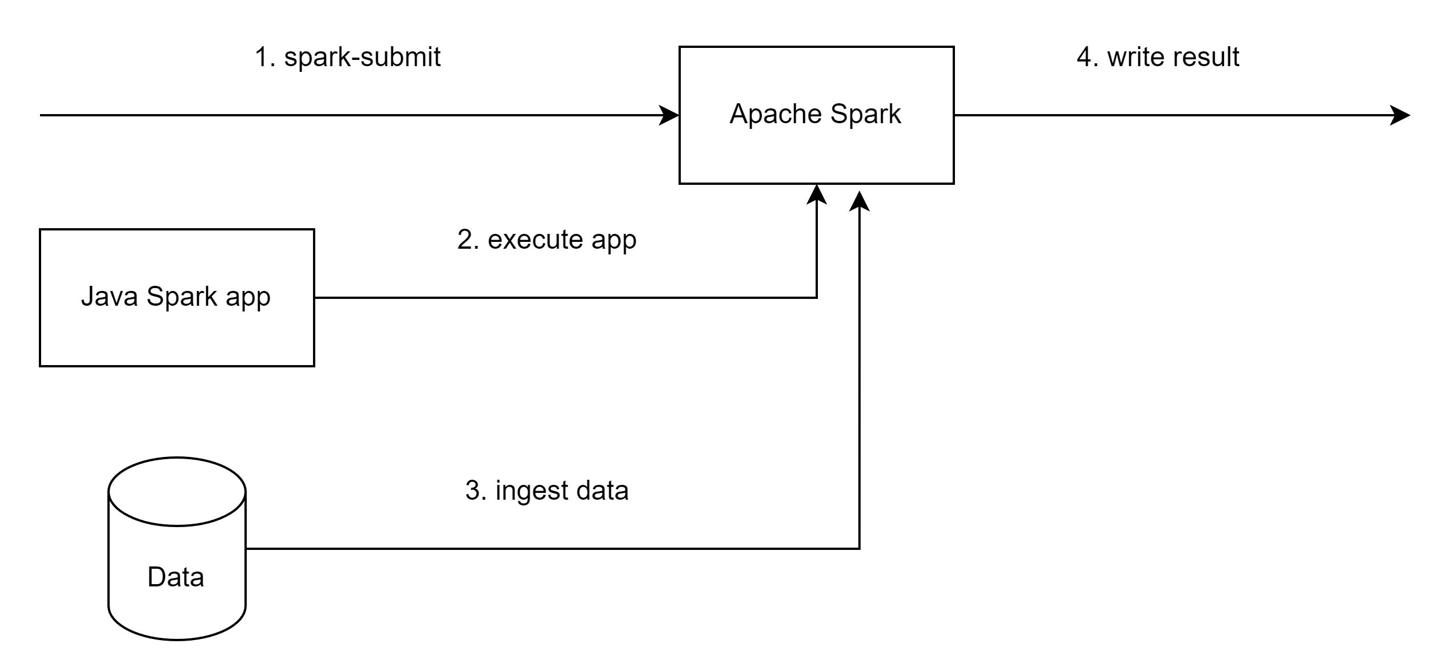
Execution Diagram

Slide 6
Demo
Show schema
Count rows
Get unique values
Aggregate
Export

Slide 7
Questions?

Slide 8
FAQ
Unit Test?
We can do unit test on smaller dataset
How do we know how much memory required?
Apache Spark will overflow data to disk.
Depending on process, might require more memory than total amount of data ingested.
Measure if disk is being used. For best performance make sure only memory is used.

Slide 9
Local Stack
Windows 11 + WSL
Java 17 (AWS Corretto)
Intellij IDEA + Maven
Docker Desktop
Bitnami Spark

Slide 10
Use Cases
ETL
Obfuscation
Analytics

